Slide 1
Oil, Gold, and Crypto: How Global Tensions are linked to Commodities
Understanding Global Financial Power Shifts Using Real-World Data
University of Europe & Avron Global Consultancy Initiative
Winter Semester 2025
Supervisors: Dr./Prof. Anjuman Patil, Prof. E. George
Team Leader: Alok Sali
Co-Leader : Sahil Santosh Dangat
Team Members
Viswas Vinayakumar Saran Jaykumar
Anindya Roy Chowdhury Deep Adhav
Apoorv Pilai Pradeep Singh
Denis sebastian Abhishek Vahatule

Slide 2
Problem Statement and Research Question
Problem Statement
Rising geopolitical tensions, sanctions, and economic shocks have increased concerns over global dependence on the U.S. Dollar (USD).
Countries are diversifying reserves into gold, energy commodities, and digital assets.
Cryptocurrencies are increasingly used in trade and financial settlements.
Research Question → How are global financial power shifts reflected across gold reserves, crude oil trade, cryptocurrency transactions, and currency systems?
Reframed Question → Will the U.S. Dollar (USD) remain the dominant global currency post July 2027?
Why This Matters
Impacts global trade and investment decisions
Influences reserve management and hedging strategies
Signals structural changes in the global financial system

Slide 3
Data Sources & Scope
Datasets Used
Gold Trade Data — UN Comtrade
Crude Oil Trade Data — UN Comtrade
Bitcoin Trading Volume — Bitcoinity
Currency Share Data — SWIFT RMB Tracker
Scope
Publicly available real-world datasets (CSV)
No synthetic or simulated data
Analysis performed using Excel / Google Sheets
Time Period
2019 – 2024 (Pre-COVID, COVID, Post-COVID)
Coverage
Gold and oil trade flows
Bitcoin trading volumes by fiat currency
USD vs BRICS currency usage trends

Slide 4
Methodology Overview
Section A: Data Cleaning & Preparation
Data import and structure validation
Column standardization and unit verification
Missing value, outlier (IQR), and duplicate checks
Creation of clean, analysis-ready datasets
Section B: Descriptive Analysis (What happened?)
Summary statistics and pivot-table analysis
Trend analysis across gold, crude oil, and Bitcoin
Comparative analysis (BRICS vs US/EU)
Visual insights using charts and tables
Section C: Exploratory Analysis (Why did it happen?)
Relationship analysis between commodities and currencies
Correlation analysis (e.g., gold vs USD strength)
Policy and macroeconomic event interpretation
Section D: Predictive Analysis (What might happen next?)
Simple forecasting techniques
Moving average trend projections
Directional insights on future commodity and currency behavior
Tools Used
Microsoft Excel and Python (for advanced analysis)

Slide 5
Section A: Data Cleaning & Preparation (Gold & Crude Oil)
Data Import & Validation
Imported gold and crude oil datasets from UN Comtrade
Verified numeric and date fields using ISNUMBER()
Annual time variable standardized using refYear
Standardization & Quality Checks
Column names standardized for clarity and consistency
Missing values identified (no forced deletion or imputation)
Duplicate records verified using composite keys
Outlier Detection (1.5×IQR)
Applied only to key numeric variables
Gold: Outliers detected due to concentrated exporters (retained)
Oil: No outliers detected, indicating broader distribution
Unit & Dataset Preparation
Gold measured in kilograms (no conversion required)
Oil standardized to barrels (BBL)
Clean, analysis-ready datasets created using Paste → Values

Slide 6
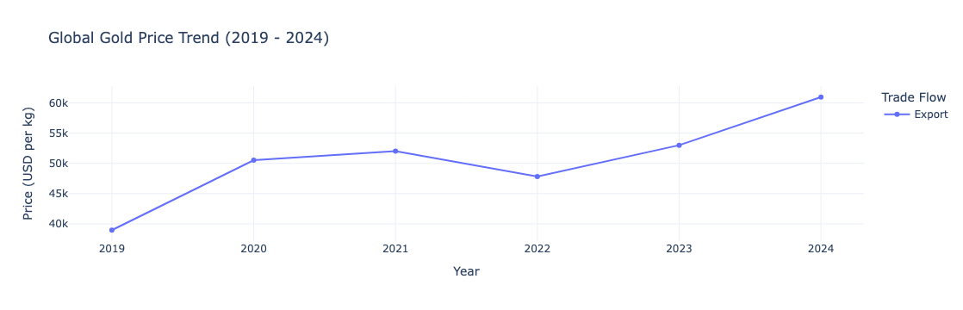
Gold Price Trends & USD Connection
Key Observations (2019–2024)
Gold prices increased during periods of global uncertainty.
After a brief correction in 2022, prices rose strongly through 2024.
Overall trend indicates long-term appreciation.
Interpretation
Gold continues to act as a safe-haven asset.
Rising prices reflect hedging behavior against USD-related risks, not a complete shift away from the dollar.

Slide 7
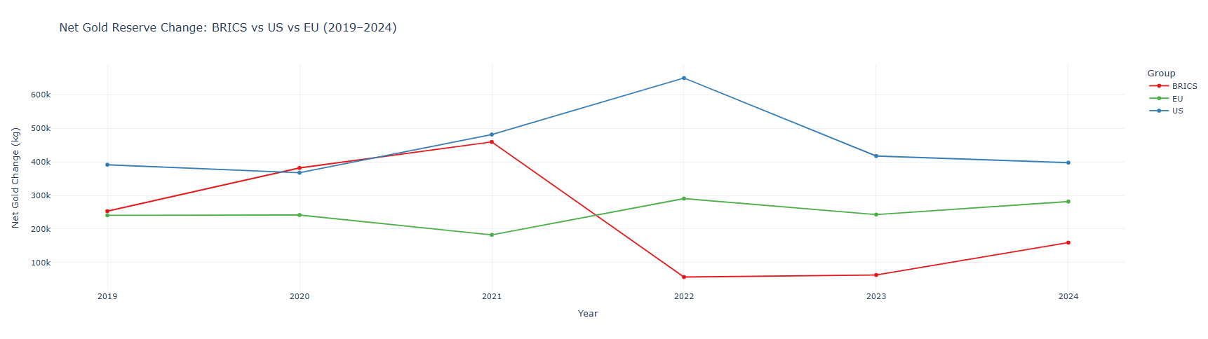
Gold Analysis: BRICS vs US vs EU
Objective → To compare gold accumulation trends across major economic blocs and identify shifts in reserve behavior.
Key Observations (2019–2024)
BRICS countries show higher volatility and periods of accelerated gold accumulation.
EU countries exhibit a more stable and consistent gold reserve pattern.
The US/EU bloc shows limited variation compared to BRICS.
Overall, gold accumulation trends indicate diverging reserve strategies across blocs.

Slide 8
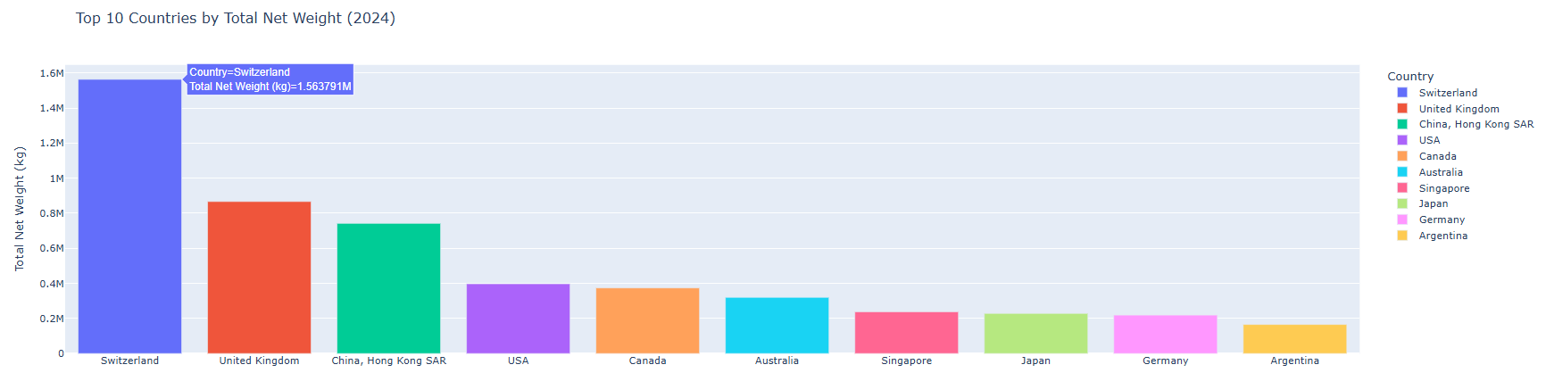
Countries with Largest Increase in Gold Reserves
Key Observations
Gold reserve growth between 2019–2024 is concentrated among a small number of countries.
Several emerging economies dominate the largest increases.
Indicates strategic long-term reserve accumulation.

Slide 9
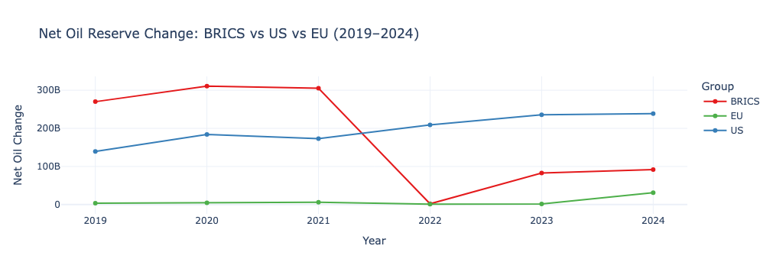
Oil Analysis: BRICS vs US vs EU
Key Observations (2019–2024)
BRICS oil reserves show high volatility, reflecting geopolitical and market sensitivity.
The US displays a steadier upward trend, indicating stronger energy security.
The EU remains relatively stable, with limited reserve expansion.
Insight → Oil trends reveal diverging energy strategies, with the US strengthening its position while BRICS experience higher exposure to shocks.

Slide 10
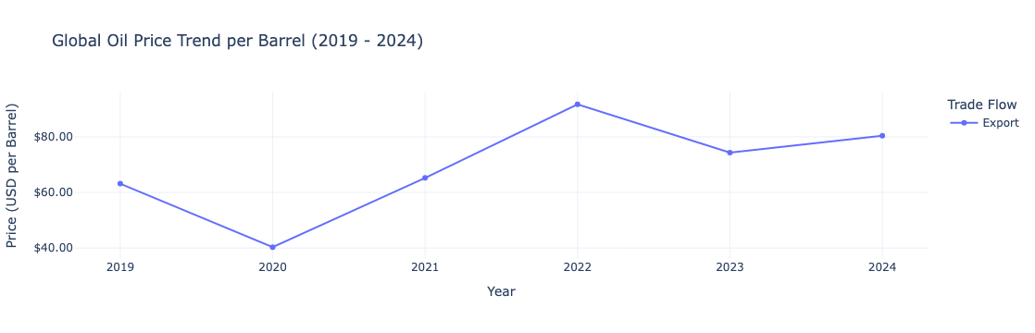
Oil Price Trend & USD Connection
Key Observations (2019–2024)
Oil prices show high volatility, especially during COVID and geopolitical conflicts.
Sharp price swings reflect supply shocks, sanctions, and production controls.
Oil price movements remain strongly USD-linked, as global oil trade is USD-denominated.
Insight
Unlike gold, oil does not act as a stable hedge against USD risk.
Instead, oil prices amplify geopolitical and currency-related shocks.

Slide 11
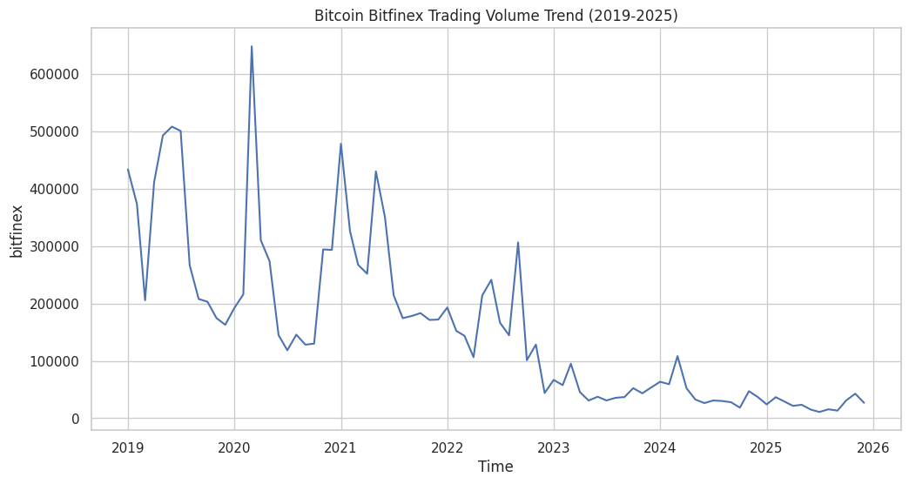
Bitcoin volume Trend
Peak Activity (2019–2021): Bitcoin trading volume on Bitfinex surged during this period, with the highest spikes around 2020. This likely reflects increased market interest during major bull runs and institutional entry.
Post-2021 Decline: Volume steadily declined from 2022 onward, suggesting reduced speculative activity, market saturation, or macroeconomic tightening.
Stabilization Phase (2023–2025): Trading volume flattens, indicating a shift toward more consistent, possibly institutional or utility-driven trading behavior.
Market Maturity: The transition from volatility to stability may signal Bitcoin’s evolution from speculative asset to mainstream financial instrument.
Liquidity Planning: Businesses and exchanges should align infrastructure with lower but steadier volume expectations post-2022.

Slide 12
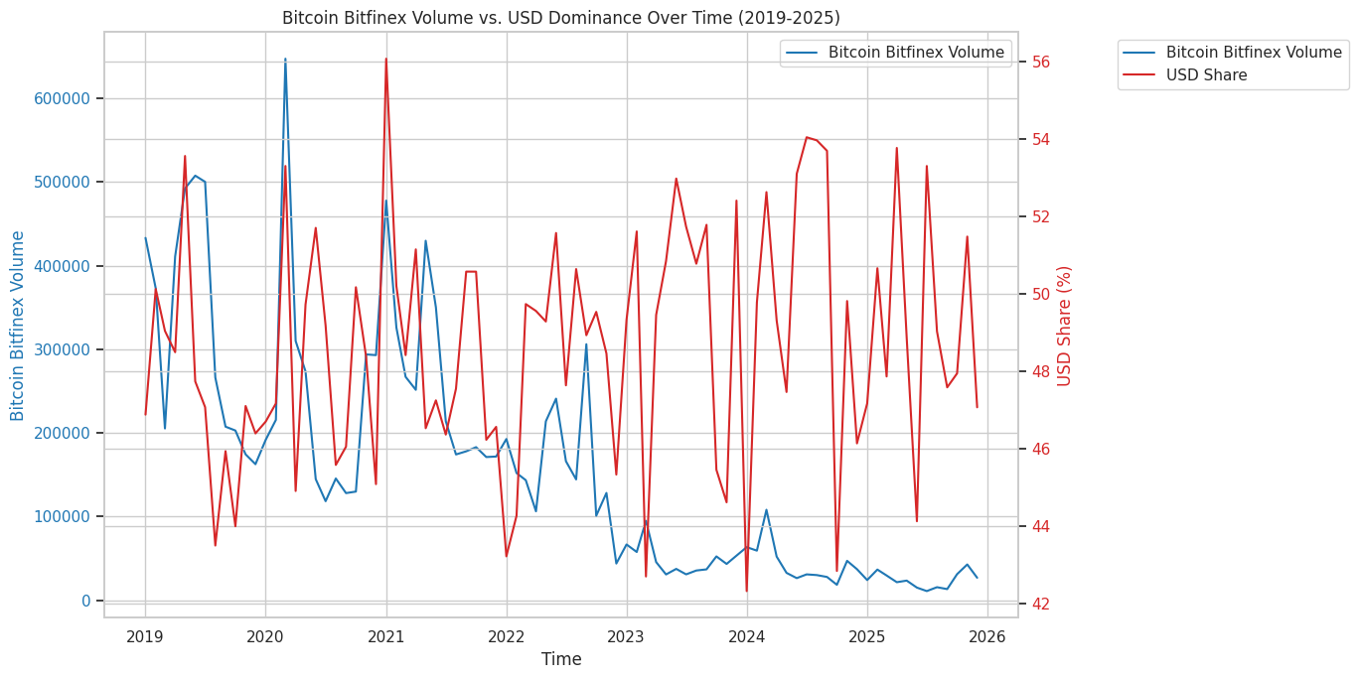
Bitcoin Vs USD
Bitcoin Volume Peaks (2019–2021): Trading volume on Bitfinex surged during this period, likely driven by speculative interest and major bull runs.
Volume Decline & Stabilization (2022–2025): A clear downward trend followed by plateauing suggests reduced volatility and possibly more institutional or long-term holding behavior.
USD Share Stability: Despite fluctuations in Bitcoin volume, USD dominance remains relatively stable between 45% and 55%, indicating its entrenched role in global crypto settlements.
No Strong Inverse Relationship: The two lines do not show a clear inverse pattern, suggesting that Bitcoin volume and USD share are not negatively correlated — they may move independently or be influenced by broader macroeconomic factors.
USD’s Resilience: The consistent USD share implies that even during crypto surges or declines, USD remains the preferred settlement currency.
Crypto Liquidity Cycles: Bitcoin volume spikes may reflect liquidity cycles tied to investor sentiment, regulatory news, or macroeconomic shifts — not necessarily currency share changes.

Slide 13
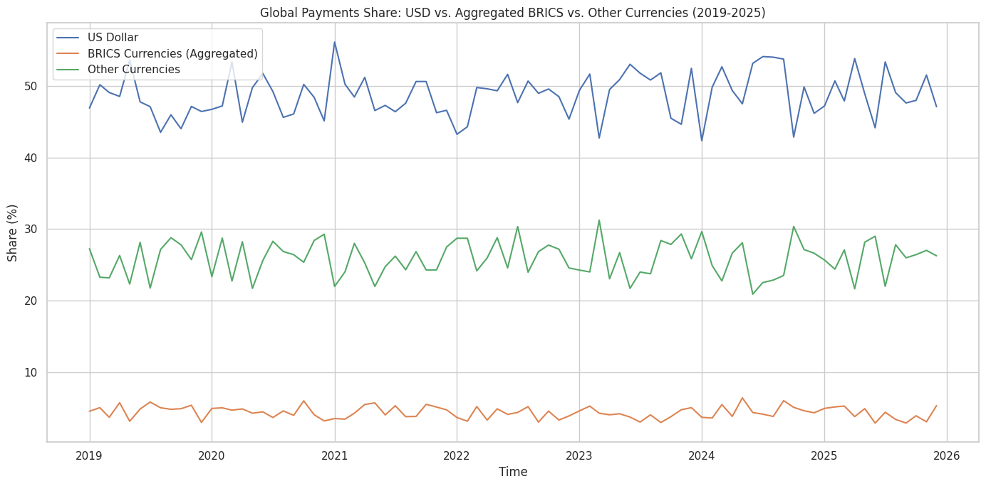
Swift Vs Brics Vs Other Currencies (2019- 2025)
USD Dominance: The US Dollar consistently holds the largest share of global payments, fluctuating between 40% and 50%. This underscores its entrenched role as the primary settlement currency worldwide.
BRICS Currencies (Aggregated): Despite geopolitical ambitions, BRICS currencies maintain a modest share between 5% and 10%, with minimal upward movement. Their influence remains peripheral in global payment systems.
Other Currencies Stability: The share of other currencies remains relatively stable around 25%–30%, suggesting a diversified but non-dominant role in global transactions.
No Major Disruptions: Across the 2019–2025 period, none of the currency groups show dramatic shifts, indicating structural stability in global payment preferences.

Slide 14
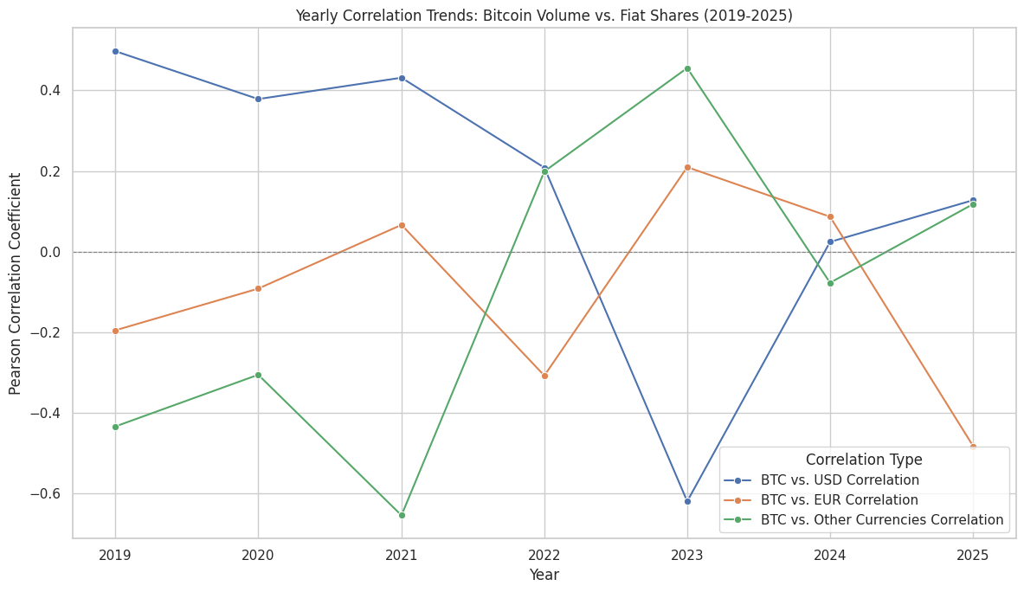
BTC Dynamics and Fiat Dominance
BTC–USD Correlation (Blue Line): Shows moderate positive correlation in early years, dips sharply in 2023, then rebounds in 2024–2025. Suggests a temporary decoupling in 2023, possibly due to macroeconomic disruptions or crypto-specific volatility.
BTC–EUR Correlation (Orange Line): Peaks in 2023, then drops steeply in 2025.Indicates a short-lived alignment between Bitcoin volume and EUR share, followed by divergence.
BTC–Other Currencies Correlation (Green Line): Peaks in 2023 and gradually declines through 2025.Reflects diminishing influence of smaller fiat currencies on Bitcoin trading volume.
USD’s Long-Term Alignment: Despite volatility, USD maintains the most consistent correlation with Bitcoin volume, reinforcing its role as the anchor currency in crypto markets.
EUR and Others: Volatile & Peripheral: Their inconsistent correlation patterns suggest limited strategic relevance for crypto settlement planning.

Slide 15
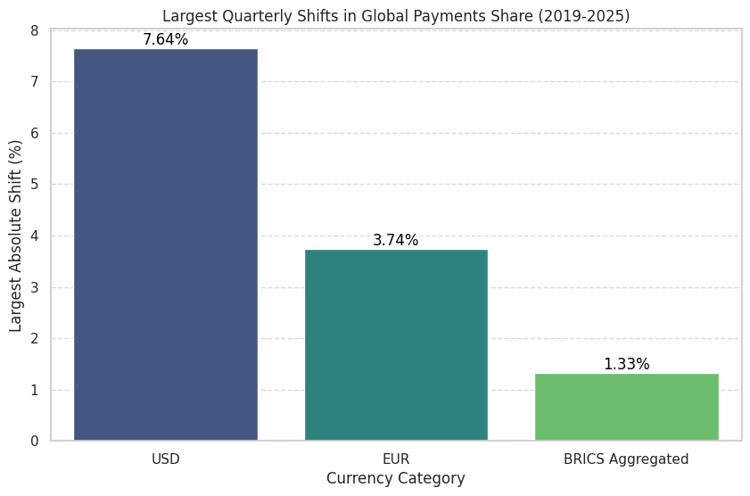
Quarterly Shifts in Global Payments Share (2019–2025)
USD Leads in Volatility: With a maximum quarterly shift of 7.64%, the US Dollar shows the highest responsiveness to global market dynamics, policy changes, or macroeconomic shocks.
EUR Shows Moderate Movement: The Euro’s largest shift is 3.74%, indicating moderate volatility — possibly tied to regional economic cycles or regulatory developments.
BRICS Aggregated Is Least Volatile: At 1.33%, BRICS currencies exhibit minimal quarterly variation, suggesting limited global influence or tightly controlled monetary environments
USD’s Dual Role: Dominant & Reactive: Its large shift range reflects both its central role and sensitivity to global financial events — making it a key currency for risk monitoring.
EUR’s Regional Exposure: Moderate shifts imply that while EUR is globally relevant, its influence is more regionally concentrated and less prone to global shocks.
BRICS Stability May Signal Rigidity: Low volatility could mean either resilience or lack of integration — important for assessing future potential in global payment systems.

Slide 16
Exploratory Analysis
Objective
To explain why the observed trends in gold, oil, and crypto occurred by identifying key relationships between variables.
Gold Buying vs USD Weakness
Analysis shows a negative relationship between gold purchases and USD strength.
When the USD weakens, countries—especially BRICS—increase gold accumulation.
Indicates hedging behavior against USD risk.
Crypto Settlement vs Oil Cargo Size
Higher crypto settlement activity is associated with smaller oil cargo sizes.
Suggests crypto is mainly used for:
  Pilot trades
  Sanctions avoidance
  Testing alternative settlement systems
Large shipments still rely on fiat currencies.
Policy Impact: UAE 0% Tax Reform
Post-policy period shows faster growth in BRICS currency usage.
Indicates that tax incentives and regulatory policies can accelerate non-USD settlements.
Exploratory Insight → Currency diversification is driven by a combination of USD risk, transaction constraints, and policy incentives, rather than a single factor.

Slide 17
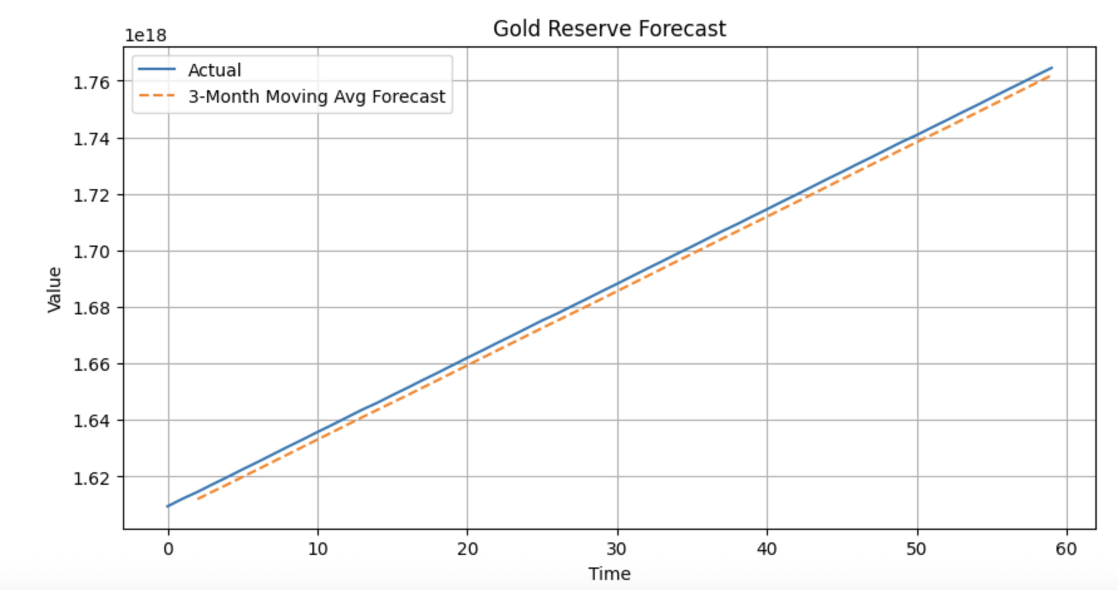
Predictive Analysis
Method
3-month moving average forecast
Used to smooth volatility and identify trend direction
Forecast Insights
Gold: Upward trend → continued safe-haven demand
Oil: Stable with mild upward pressure
Bitcoin: Volatile short-term, rising long-term
BRICS currencies: Increasing settlement share
USD: Relative growth slowing
Key Takeaway → Future global finance points toward gradual de-dollarization, driven by diversification rather than sudden replacement.

Slide 18
Key Findings & Research Answer
Key Findings
Gold accumulation increases during periods of USD weakness.
Oil remains strategically important but is not a stable hedge.
Bitcoin shows growing relevance as a digital alternative.
BRICS currencies are gradually gaining settlement share.
Final Answer
The USD is unlikely to lose dominance abruptly.
However, evidence points toward a slow transition to a multi-currency global system post-2027.

Slide 19
Policy & Investment Implications
For Policymakers
Support diversified settlement systems.
Expect rising role of BRICS currencies in regional trade.
Monitor crypto usage in cross-border transactions.
For Investors
Gold remains a strong hedge against USD risk.
Bitcoin offers diversification but with higher volatility.
Balanced portfolios benefit from asset and currency diversification.

